Slide 1
Cloud Computing & Storage
&
Hands-on Data Analytics
Arcot (Raja) Rajasekar
rajasekar@unc.edu
Unit #04

Slide 2
Unit #04
Hands on with KNIME

Slide 3
What is KNIME
A visual tool for information analytics
You build workflows on a GUI interface by connecting various applications.
Easy to use and to port
Has a very good interface to R
KNIME Web site:
  https://www.knime.org/

Slide 4
KNIME Videos
Videos to watch
Intro
  https://www.youtube.com/watch?v=ft7Ksgss3Tc
A good video to install and use KNIME
  https://www.youtube.com/watch?v=qp1aOA4OD6E
A fast paced use of KNIME:
  https://www.youtube.com/watch?v=V1KbJL4uutQ

Slide 5
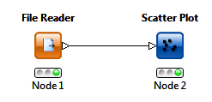
Simple Example: Query Plot
Two nodes in a KNIME project
  File Reader node loads CSV file
  Creates table with field names
  Scatter Plot node creates the chart

Slide 6
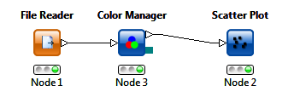
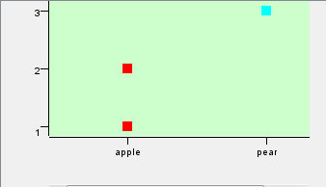
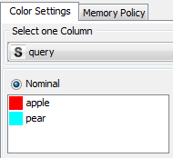
Simple Example: Query Plot
Add separate color for each query value

Slide 7
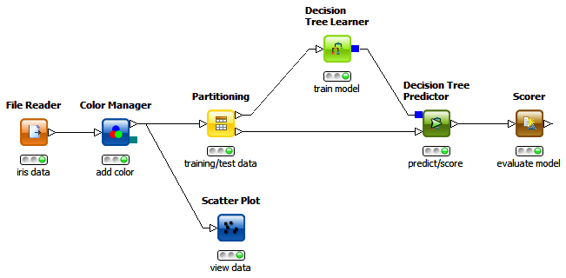
Workflow – Decision Trees

Slide 8
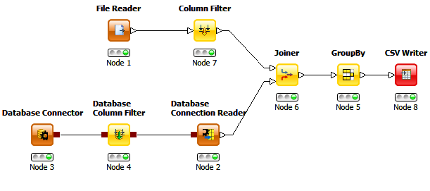
Database and KNIME

Slide 9
KNIME Hands-On

